Slide 1
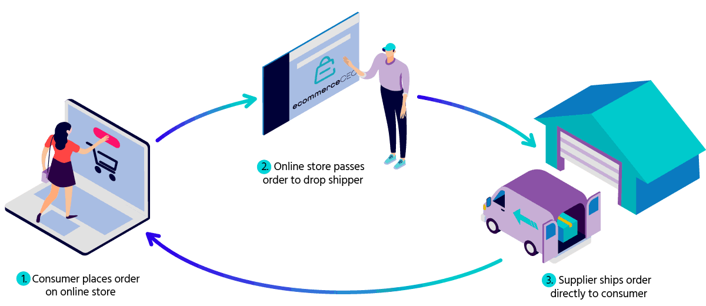
Shopmart Shopping Center

Slide 2
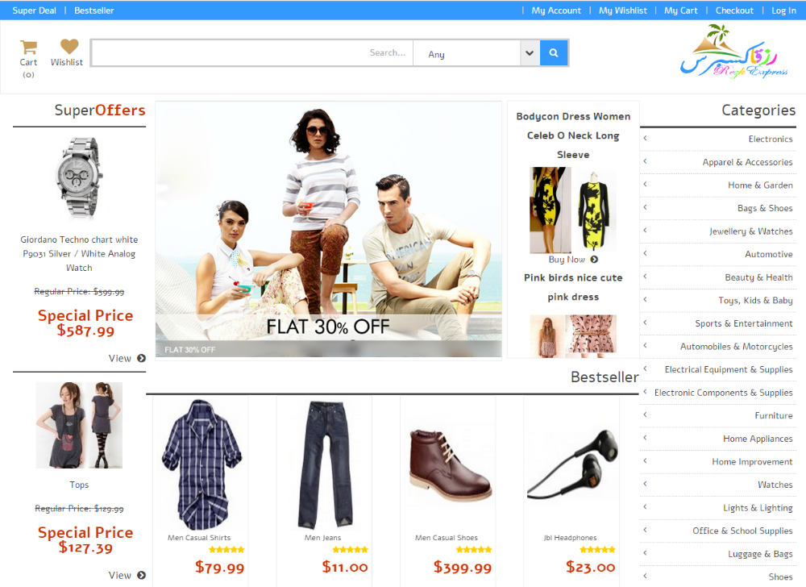
Home Page Services
Product Advertise
International Shop Links

Slide 3
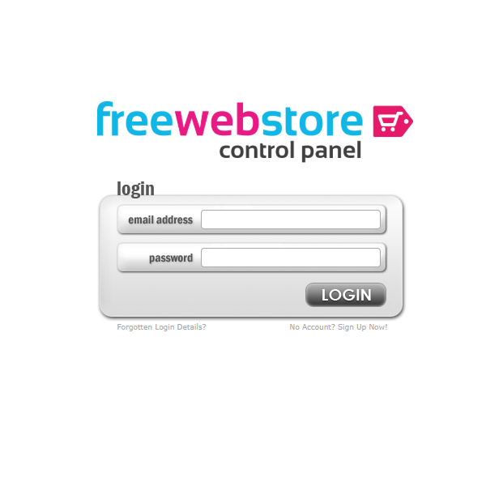
Owner Login interface

Slide 4
Buyer Login Interface

Slide 5
Advertise Login Interface

Slide 6
Carrier Login Interface

Slide 7
Features
Pre–Order option.
Carrier job sector.
Buyer can track the product.
Free login for all items.

Slide 8
Advantage
Trade scope for Businessman.
Carrier will get Max profit.
Foreign product order without master card.
Buyer will get link for live track.

Slide 9



Developing Tools

